Slide 1
NLD simulations
2018-02-20

Slide 2
NLD test run
NLD range: 100 to 20, steps of 80
Slechts 5 Monte Carlo cycli

Slide 3
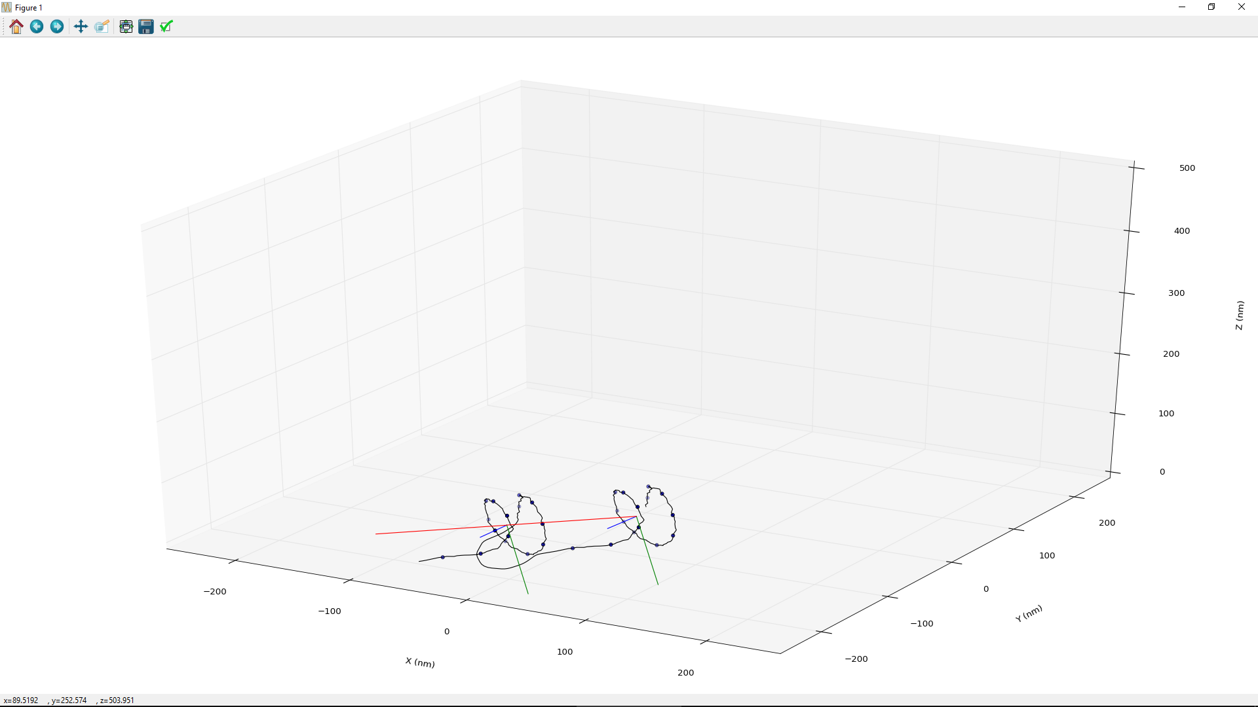
NLD = 100

Slide 4
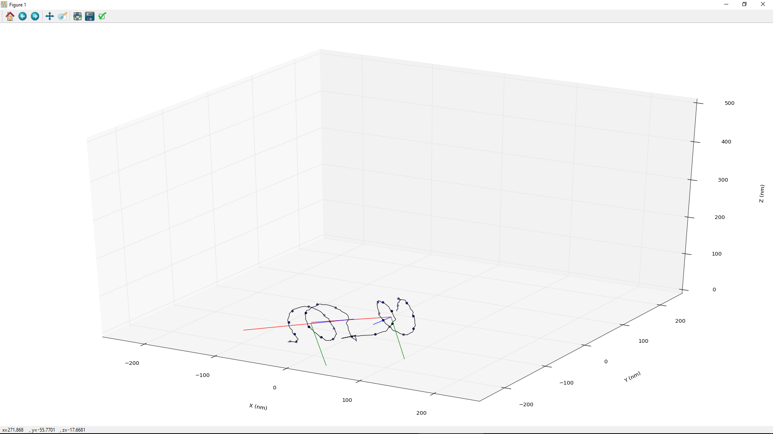
NLD = 20

Slide 5
NLD test run
NLD range: 100 to 20, steps of 80
Slechts 35 Monte Carlo cycli

Slide 6
NLD = 100

Slide 7

NLD = 99

